Slide 1
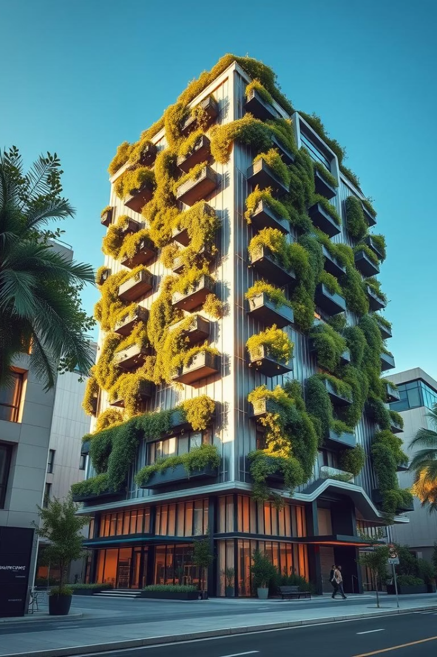
Smart Buildings: The Future of Sustainable Infrastructure
Smart buildings utilise advanced technology to optimise resource consumption and enhance the indoor environment. The global market is rapidly expanding, driven by a focus on sustainability, efficiency, and superior user experience.

Slide 2


Defining a Smart Building
Integrated Systems
Data-Driven Insights
Occupant Well-being
Seamless control of HVAC, lighting, security, and energy networks.
Automation based on real-time data for optimised performance.
Prioritising comfort, health, and productivity for occupants.

Slide 3





Benefits of Smart Buildings
Energy Savings
Reduced Costs
Enhanced Security
20-30% reduction in consumption.
Predictive maintenance minimises downtime.
Integrated access and surveillance systems.
Improved Comfort
Personalised environmental controls.
Smart buildings offer significant advantages, from substantial energy and cost reductions to enhanced security and occupant satisfaction, ultimately increasing property value and attractiveness.

Slide 4
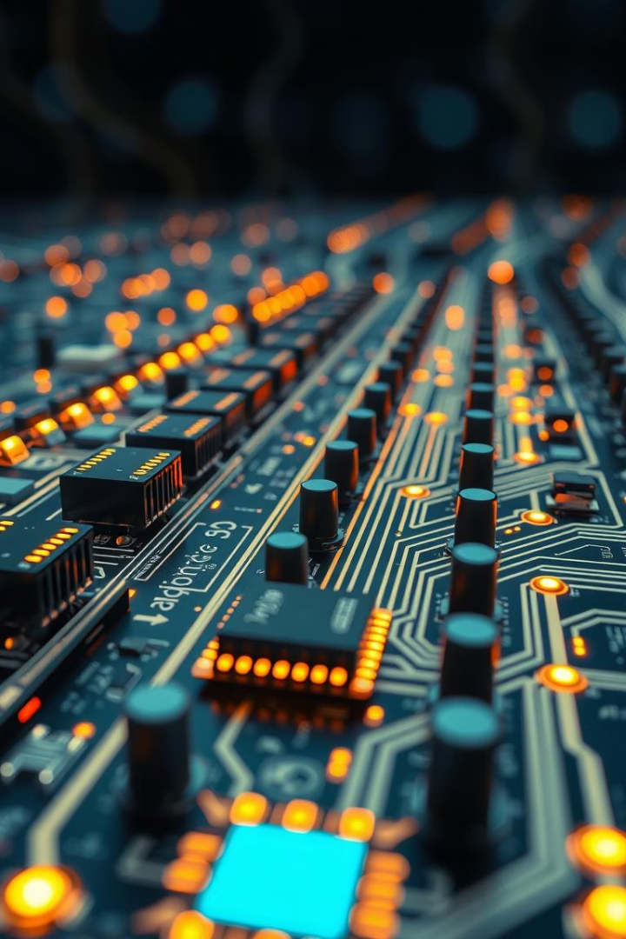




Core Technologies
IoT Sensors
Real-time data collection.
BMS
Centralised control and monitoring.
AI & ML
Predictive analytics, optimisation.
Cloud Computing
Scalable data storage and processing.

Slide 5
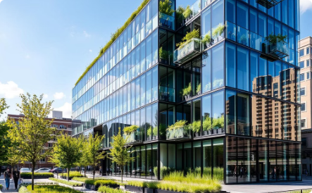
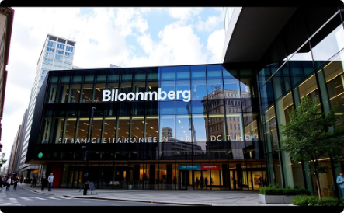

Smart Building Examples
The Edge (Amsterdam)
28,000 sensors for energy and space optimisation, BREEAM Outstanding (98.4%).
Bloomberg HQ (London)
Natural ventilation reduces energy by 35-70%, water savings of 73%.
Capital Tower (Singapore)
Real-time energy monitoring, smart lighting, Green Mark Platinum rating.

Slide 6





Challenges and Considerations
Cyber Security
1
Protecting OT from attacks.
Skills Gap
2
Training for new technologies.
Integration Complexity
3
Ensuring system compatibility.
Data Privacy
4
Securing sensitive information.
Initial Investment
5
Balancing cost with benefits.
Implementing smart building technologies presents challenges such as high upfront costs, complex system integration, and the need for skilled personnel. Critical considerations include data security, privacy protection, and robust cyber security measures to safeguard operational technology.

Slide 7
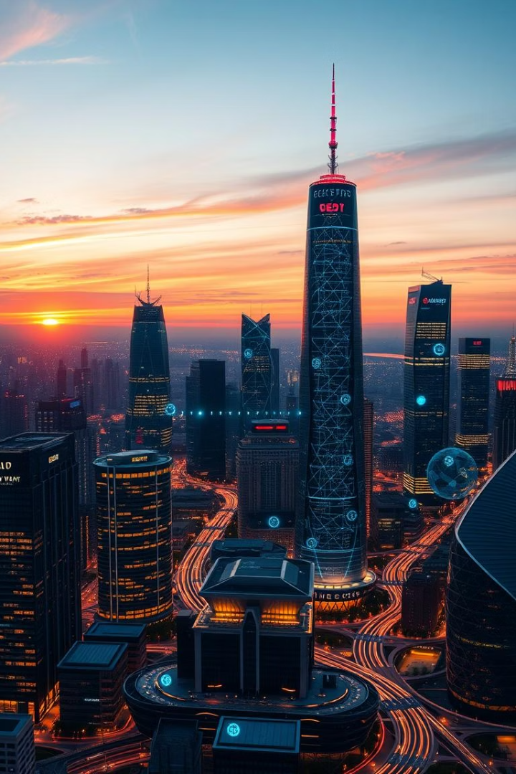
Future Trends in Smart Buildings
Smart Grids Integration
Connecting with renewable energy sources.
Advanced AI
Increased predictive analytics and autonomy.
Health & Well-being
Focus on air quality, lighting, and biophilic design.
Digital Twins
Virtual replicas for simulation and optimisation.

